Slide 1
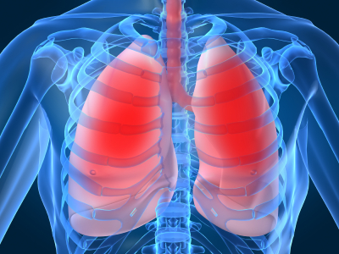
LECTURE NO (3)
Respiratory Physiology Bader Hassan
Lung volumes &
Capacities
Dept.Of Physiology

Slide 2
Lung volumes & Capacities
Pulmonary ventilation
It is process of air flowing into the lungs during inspiration and out of the lugs during expiration, air flows because of the pressure difference between the atmosphere and the gases inside the lungs.

Slide 3
Lung volumes & Capacities
The air in the lungs has been subdivided in to four volumes and four capacities .
Lung volumes:
(1) Tidal volume (TV)
is the volume of air inspired or expired with each normal breath. It amount about 0.5L, in adult males and females at the rest.
Can be measured by the Spirometer.
(2) Inspiratory reserve volume (IRV):
The air inspired with maximal inspiratory effort in excess of the tidal volume, 3L in adult males , 1.9L in adult females.
* Can be measured by the Spirometer.

Slide 4
(3) Expiratory reserve volume (ERV) :
is the extra amount of air that can be expired by forceful expiration after the end of a normal tidal expiration. = 1L in adult males, 0.7 in adult females.
* Can be measured by the Spirometer.
(4) Residual volume (RV):
is the volume of air remaining in the lung after the most forceful expiration.
= 1.2L in adult males, 1.1L in adult females.
* Cannot measured by the Spirometer.

Slide 5
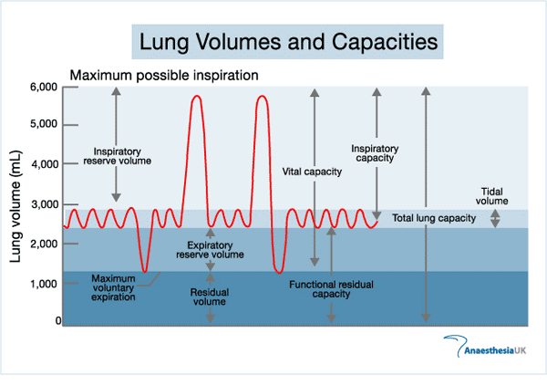
CON

Slide 6
Pulmonary capacities
Are combination of two or more volume.
(1) Inspiratory capacity (IC):
volume of air breathed by a maximum inspiration at the end of a normal expiration.
IC =TV+IRV.
* Can be measured by the Spirometer.
(2) Function residual capacity (FRC):
volume of air remaining in lungs at the end of normal expiration.
FRC=ERV+RV.
* Cannot measured by the Spirometer.

Slide 7
(3)The vital capacity(VC):
The largest amount of air that can be expired after amaximal inspiratory effort,it gives useful information about the strength of the respiratory muscles and other aspect of pulmonary function.
VC = IRV+TV+ERV
* Can be measured by the Spirometer.

Slide 8
(4) Total lung capacity(TLC):
Volume of air accommodated by the lungs at the end of a maximal inspiratory
TLC = IRV+TV+ERV+RV
* Cannot measured by the Spirometer.

Slide 9
FEV1 (Forced expiratory volume in 1st second):
the fraction of vital capacity expired during the first second of a forced expiration.
It equals more than 3quarters of the FVC
(i.e. more than 75%) FEV1/FVC ratio > 75%
FVC (Forced Vital Capacity): the total volume of air expired forcefully by maximum expiration following maximum inspiration.

Slide 10
Pulmonary ventilation minute volume
The normal frequency of breathing varies between 12-15 breaths per minute.
The amount of air inspired per minute, is normally about 6L = (500* 12 breath /min)
Minute alveolar ventilation :is the amount of air that reaches the alveoli in 1minute, is less than the respiratory minute volume.
normally about 4.2L = (350* 12 breath /min)

Slide 11
Dead space
Some of air a person breathes never reaches the gas exchange area but instead goes to fill respiratory passages where gas exchange does not occur, such as in the nose pharynx and trachea ,this air is called dead space.
The volume of the anatomical dead space is about 150 ml.
Physiological dead space :is include gas in the alveoli that does not participate in gas exchange (Wasted ventilation), less than 5ml

Slide 12

(3) Vital capacity(VC):
The largest amount of air that can be expired after amaximal inspiratory effort,it gives useful information about the strength of the respiratory muscles and other aspect of pulmonary function.
VC = IRV+TV+ERV.
(4)Total lung capacity(TLC):
Volume of air accommodated by the lungs at the end of a maximal inspiratory
TLC = IRV+TV+ERV+RV

